Slide 1
In the name of Allah
Compress BMP Files
Mohammad Javad Zandiyeh
9831032
Linear Algebra project 3

Slide 2
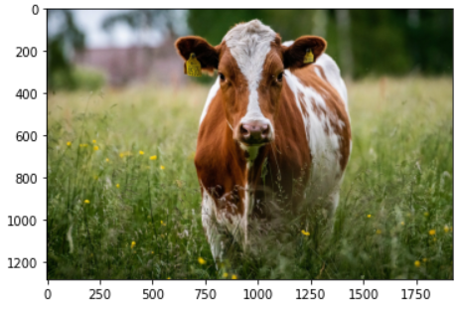
Picture 1.bmp Main File

Slide 3
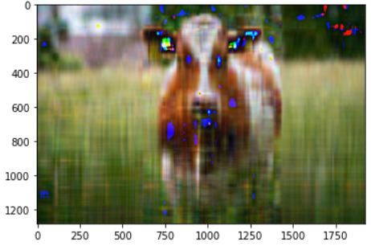
Picture 1.bmp Compressed File with K=10

Slide 4
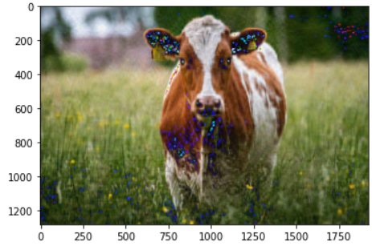
Picture 1.bmp Compressed File with K=50

Slide 5
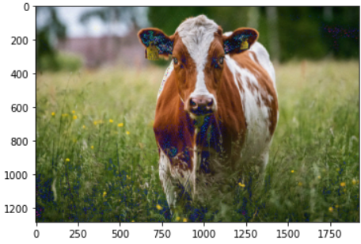
Picture 1.bmp Compressed File with K=150

Slide 6
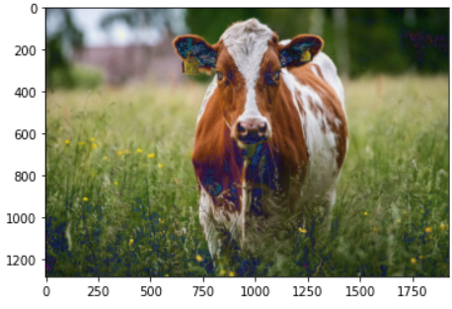
Picture 1.bmp Compressed File with K=250

